Slide 1
Linear Regression: optimization and data normalization

Slide 2
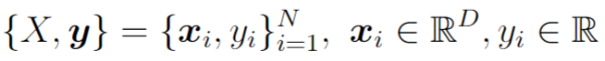
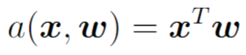
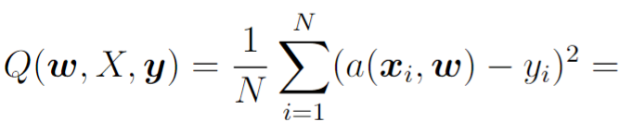
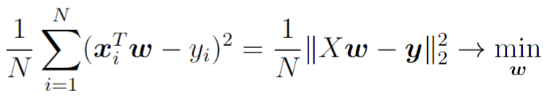
Linear model for regression
Training dataset
ML model
MSE loss function
Analytical solution

Slide 3
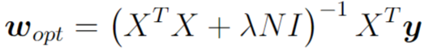
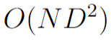
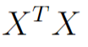
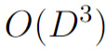
Linear regression with L2 regularization
Regularization balances approximation quality on the training set and simplicity of predictor for good generalization ability
Analytical solution:
Computational complexity of analytical solution:
for computing
for linear system solving
For large N or D finding analytical solution is too complicated.

Slide 4
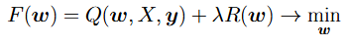
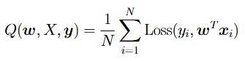
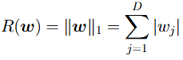
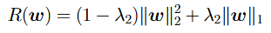
Linear regression with other losses/regularizers
Loss function can be MAE, MAPE, Huber loss, non-symmetric loss, MLSE, etc.
Regularizer also can be different:
Analytical solution for weights can be found only for the case of MSE loss + L2
Solution: let’s use numerical optimization routine

Slide 5
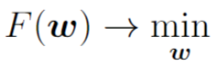
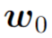
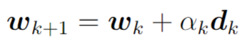
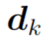
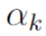
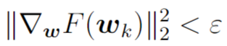
Numerical optimization
Initialize weights
Make optimization steps
Until some convergence criteria is met
- optimization direction
- step size / learning rate

Slide 6
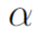
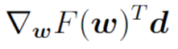
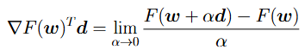
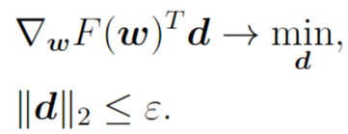
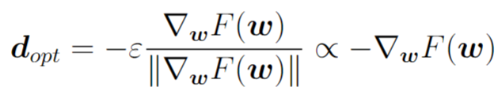
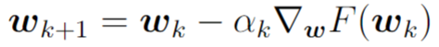
Gradient Descent (GD) optimizer
Let’s consider Taylor series expansion for function being optimized
For small enough a level of decrease is determined by
- directional derivative
Let’s find the direction with the most decrease
Gradient Descent step:

Slide 7
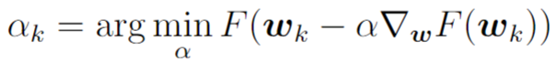
Gradient Descent optimizer
Optimization step:
Learning rate is chosen automatically by solving non-exact 1d minimization problem with Armijo/Wolfe condition (for faster computations)

Slide 8
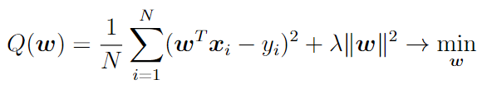
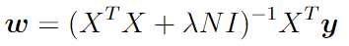
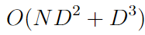
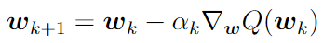
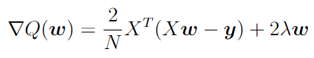
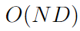
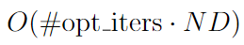
GD for linear regression
Analytical solution:
Computational costs:
Gradient descent:
Computational costs of one iteration:
Total computational costs:

Slide 9
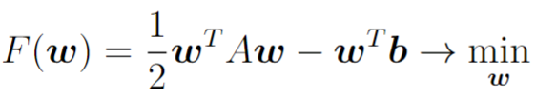
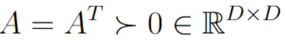
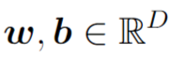
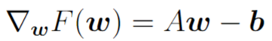
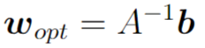
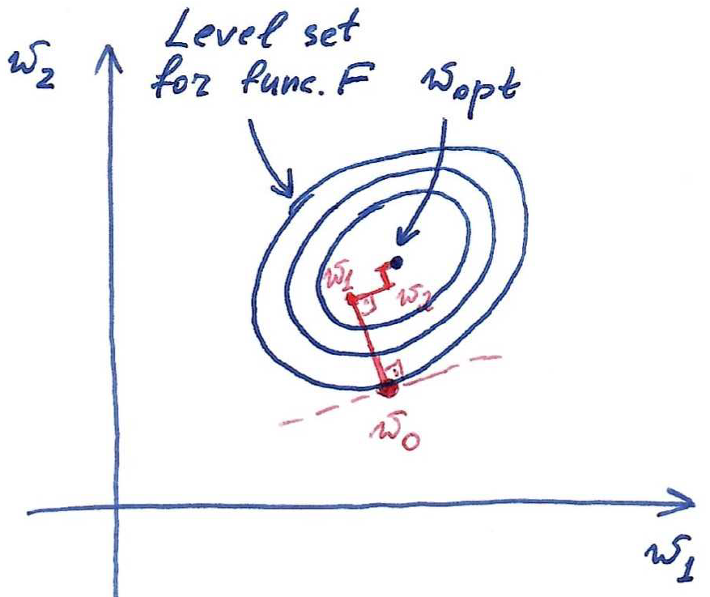
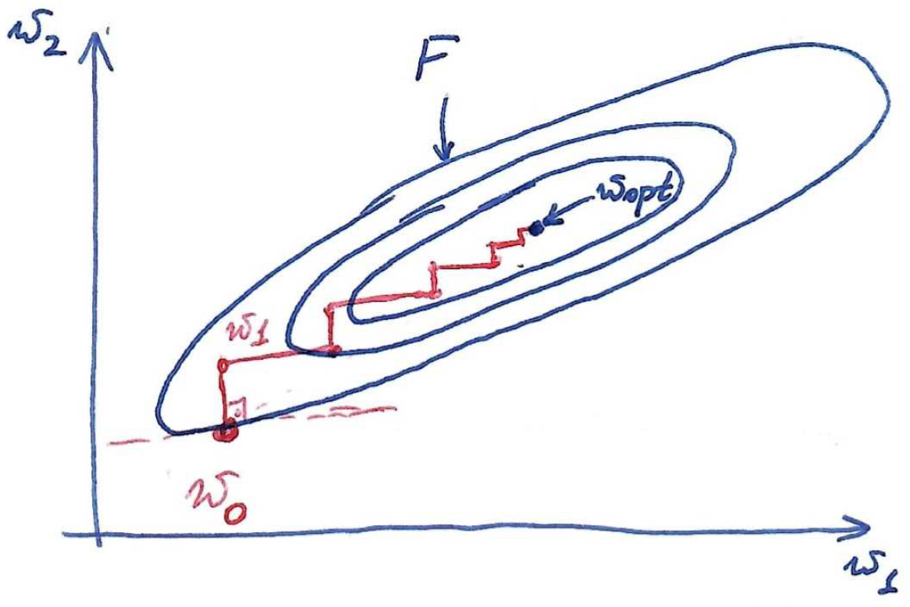
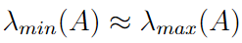
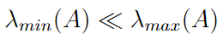
GD for quadratic function

Slide 10
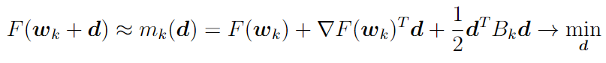
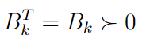
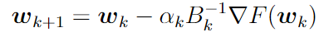
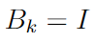
GD as approximation model
For GD:
In case of poorly scaled functions we have a mismatch between function and its approximation model

Slide 11
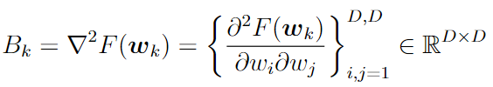
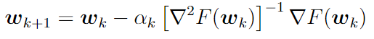
Newton optimizer
For Newton:
- Hessian matrix
Hessian matrix helps in function curvature estimation
Newton iterate:

Slide 12
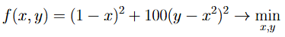
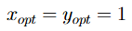
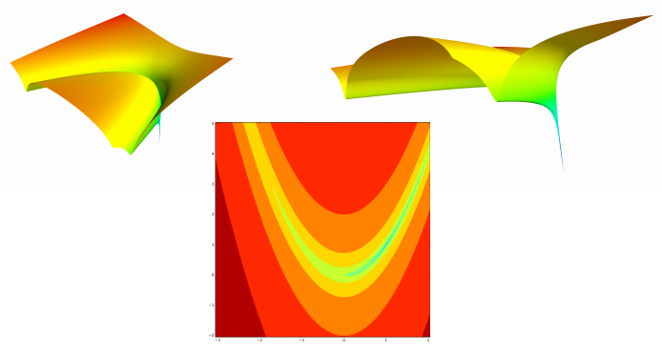
Example: Rosenbrock function

Slide 13

Example: Rosenbrock function
GD vs. Newton for Rosenbrock function

Slide 14


Example: Rosenbrock function
GD trajectory
Newton trajectory

Slide 15


Newton optimizer
Optimization step
Memory:
Computational costs:
Newton method is good w.r.t. number of iterations needed for convergence, but is very costly procedure!

Slide 16
Practical optimizers
Good optimizers have computational complexity and memory requirements similar to GD and optimization steps similar to Newton. Examples:
Conjugate Gradient
Newton-CG
L-BFGS
and others…

Slide 17


Using optimizers from scipy.optimize.minimize
Implement function that for given set of parameters returns function value and its gradient
Call optimization routine from scipy.optimize

Slide 18

Data normalization
x – apartment, y – its cost
Different features are measured in different scales. This leads to different influence of weights to prediction.

Slide 19






Data normalization
Initial dataset
Normalization for target variable:
Mean value for each feature:
Variance value for each feature:
Normalization:

Slide 20


Data normalization on inference
All normalizing coefficients (means and variances) should be stored in memory
For test objects their features should be normalized in the same way, and target variable should be restored from normalized predictions

Slide 21



Alternative way of data normalization

Slide 22


Data normalization from optimization viewpoint
After normalization

Slide 23


Data normalization w.r.t. regularization
Equivalent formulation:
In case of unnormalized data different regularization coefficients for different weights should be used.

Slide 24


Data normalization w.r.t. computation
In floating point arithmetic only relative precision is ensured:
In practice computations with big absolute values of numbers may lead to numerical instabilities

Slide 25
Elements of ML pipeline for linear regression
1. Prepare your features for training with linear regression model
Exploratory data analysis, categorical features conversion
2. Add data normalization within ML pipeline
Use sklearn.preprocessing and sklearn.pipeline
3. Add regularizer and tune regularization coefficient
Use sklearn.model_selection
4. Choose optimizer
Use e.g. L-BFGS for normal datasets and some stochastic optimizer
for large datasets
5. Control quality of obtained predictor with cross validation
Use sklearn.metrics and sklearn.model_selection

Slide 26
Stochastic Optimization

Slide 27
Optimization for linear regression
Gradient descent:
Computational costs of one iteration:
Total computational costs:
Using GD and other classic optimizers can be complicated for large datasets, i.e. when N is large. Solution: stochastic optimizers.

Slide 28





Recap on random variables
Discrete random variable x is determined by its pmf (probability mass function)
One sample from pmf can be arbitrary. With many samples their ratios converge to probability values.

Slide 29





Recap on random variables
Real-valued random variable x is determined by its pdf (probability density function)

Slide 30






Main statistics of random variables
Mean or Expected value (typical value):
Variance (deviation from typical value):
Standard deviation:

Slide 31


Main statistics of random variables
Three-sigma rule:

Slide 32









Estimating mean value by averaging samples
Suppose computational cost for drawing one sample x
Computational cost for
Very slow decrease w.r.t. j

Slide 33









Optimization for large datasets
Here is loss function for i-th object and
is some regularizer
Computational costs for
Computational costs for
Stochastic optimizers = methods with computational costs of one iteration that do not depend on N

Slide 34



Stochastic Gradient Descent (SGD)
SGD = take one random object from the dataset to estimate the gradient:
Computational costs of one SGD iteration:
Stochastic gradient is unbiased estimate of full gradient:

Slide 35



SGD with mini-batches
Take several random objects from the dataset and average:
Big mini-batches have high computational costs but doesn’t sufficiently reduce standard deviation of stochastic gradient
Computational costs of one SGD iteration with mini-batch:

Slide 36

SGD with mini-batches
Implementation:

Slide 37


SGD for one-dimensional linear regression

Slide 38


SGD vs GD
In full-batch GD step size is automatically adapted looking at
In SGD step size should be tuned by user
In SGD stopping moment is determined by user
In full-batch GD there is a valid stopping criteria:

Slide 39



Choosing step size in SGD
For SGD it is possible to prove the following theoretical result:

Slide 40



Constant step size in SGD
Output of optimizer is averaged point:

Slide 41





Diminishing step size in SGD
For Full GD:
For SGD:

Slide 42


Scaling of SGD steps
GD iteration:
GD works bad for poorly scaled functions
Newton iteration:
Goal: find easy-to-compute scaler (not full Hessian) in stochastic case

Slide 43



SGD + momentum
Heavy ball interpretation
Adding momentum is equivalent to geometric averaging of previous gradients

Slide 44


AdaGrad and RMSProp
AdaGrad uses component-wise scaling (diagonal approximation of curvature matrix)
RMSProp allows to forget earlier curvature estimations (good for non-convex functions)

Slide 45

ADAM
ADAM combines momentum idea with averaging of gradients and RMSprop idea of component-wise scaling
Sometimes ADAM is prone to overfitting (for non-convex functions) and in this case SGD+momentum should be used

